Slide 1
Workfolow vs AI Agent

Slide 2
Problem Statement
Customers report various order-related problems that require quick and consistent resolution.

Slide 3
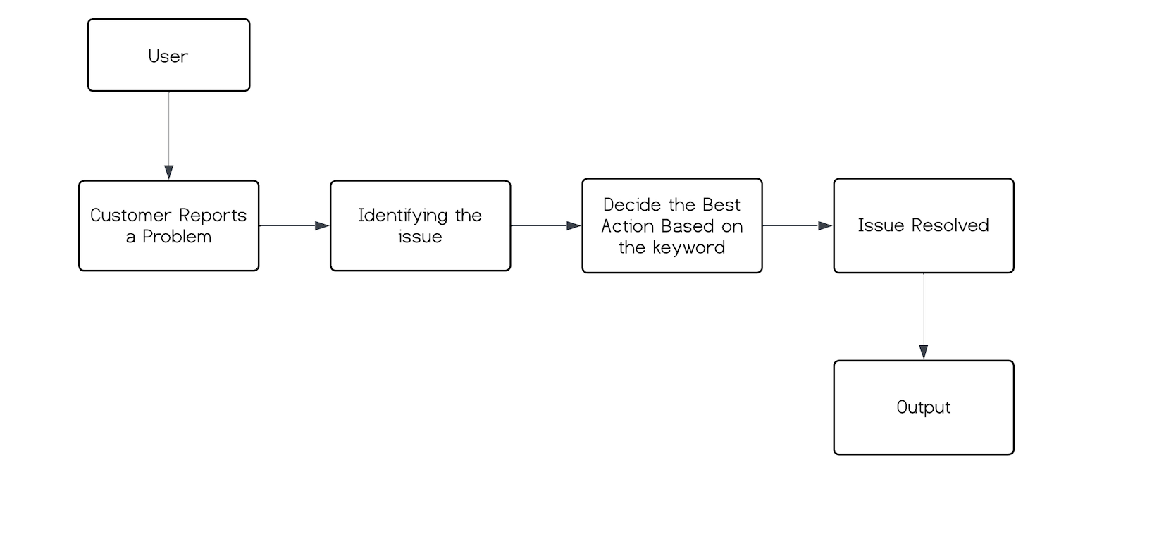
Workflow

Slide 4
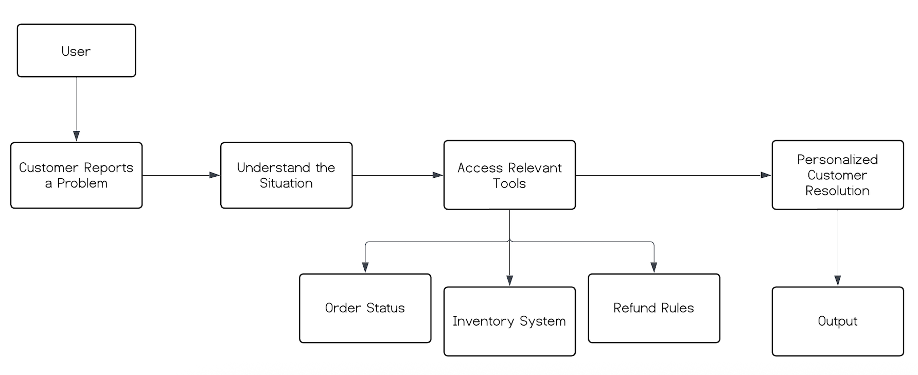
AI Agent

Slide 5

AI Workflow vs AI Agent
AI Workflow
AI Agent
Follows a fixed sequence of steps
Uses predefined rules and conditions
Predictable and consistent outcomes
Easy to test, debug, and audit
Best suited for repetitive and well-defined tasks
Makes dynamic decisions at runtime
Uses LLM-based reasoning and context understanding
Selects tools based on the situation
More flexible and adaptive
Best suited for complex, evolving, or decision-heavy tasks

Slide 6
Conclusion
AI workflows are best for stable, repeatable tasks that require predictable outcomes, low cost, and easy maintenance.
AI agents are ideal for complex, context-driven problems where adaptability and intelligent decision-making are more important than strict predictability.

